Slide 1
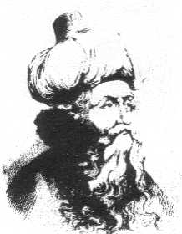
Muḥī al-Dīn Muḥammad ibn ‘Alī ibn-‘Arabī محی الدین محمد ابن علی ابن عربی
A Mystic, Philosopher, Poet al-Shaykh al-Akbar The Magister Maximus (A.H. 560-638/A.D. 1165-1240) Prepared by: pathofmystics.com

Slide 2
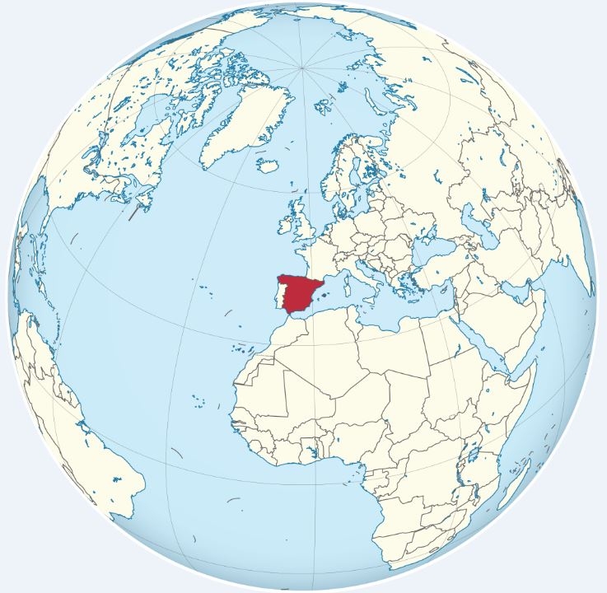
Spain

Slide 3
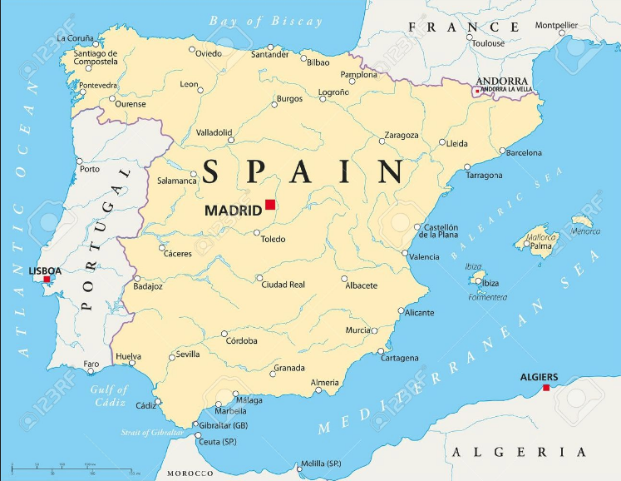
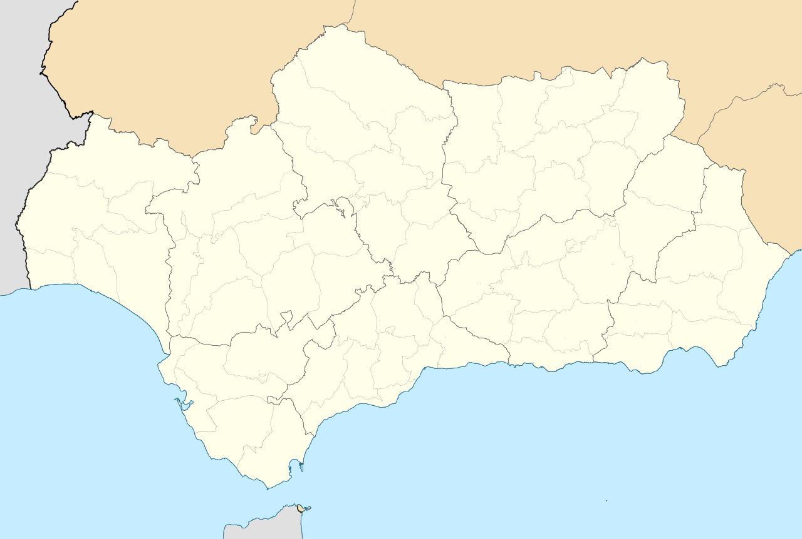
Mursiya in al-Andalus (Murcia in present-Day Spain)

Slide 4
Birth to Death
Born in Murcia
Move to Seville – 7 years old
Travel to Tunis – 30 years old
Vision instructed him to travel to East
Pilgrimage to Mecca in 1202 - 37
Extensive Travels: Egypt, Iraq, Syria, Rum (Turkey)
Settled in Damascus, Syria with a circle of his disciples until his death 1240 (75 years old). – 17 years

Slide 5
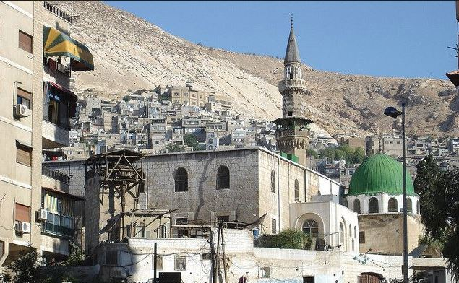
Mohi al-Din Bin Arabi Mosque – Damascus, Syria

Slide 6
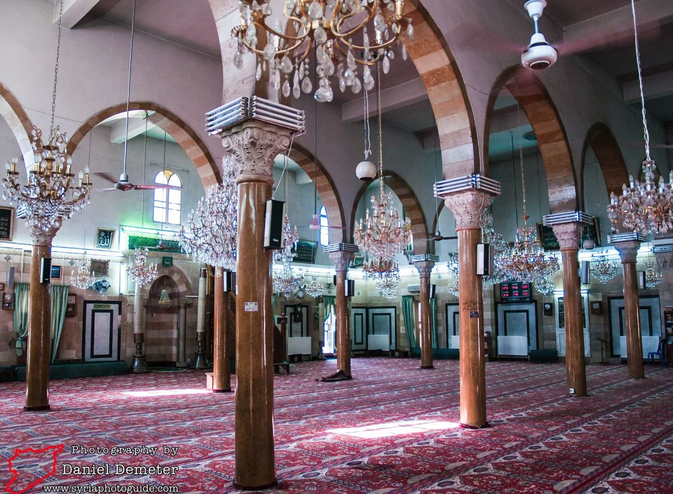
Mohi al-Din Bin Arabi Mosque – Damascus, Syria

Slide 7
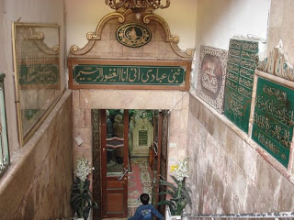

Slide 8
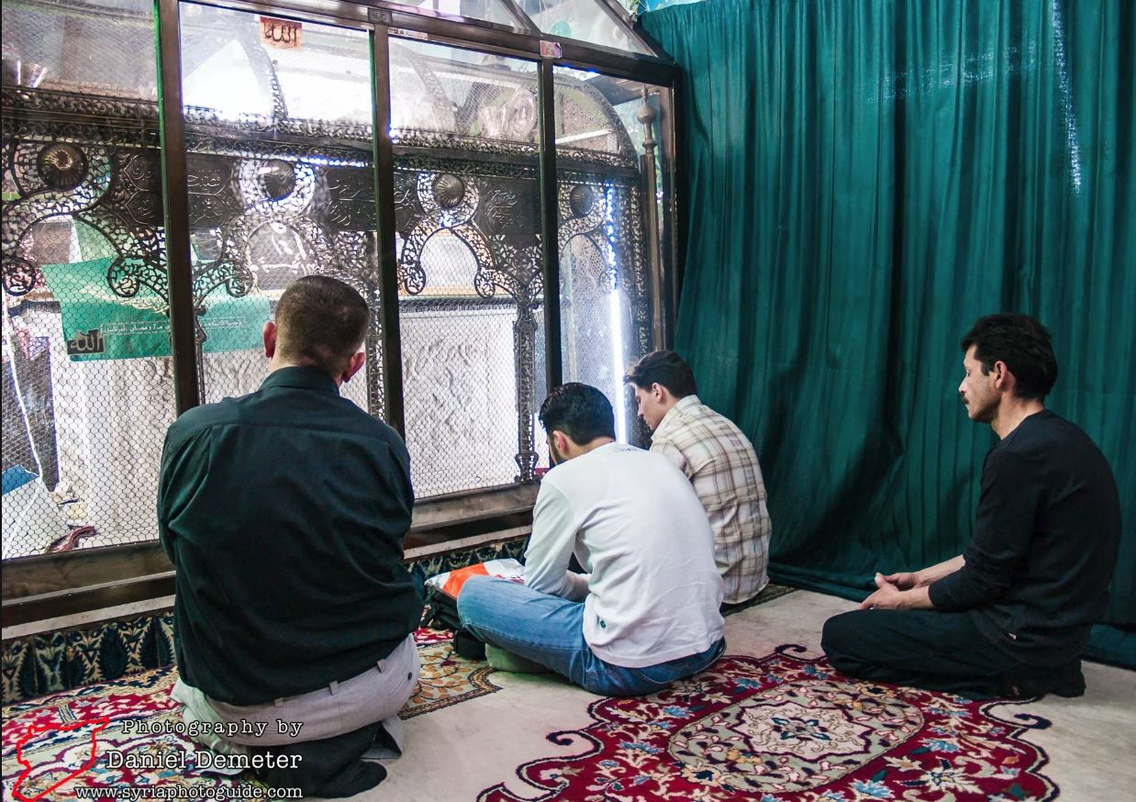
Grave

Slide 9
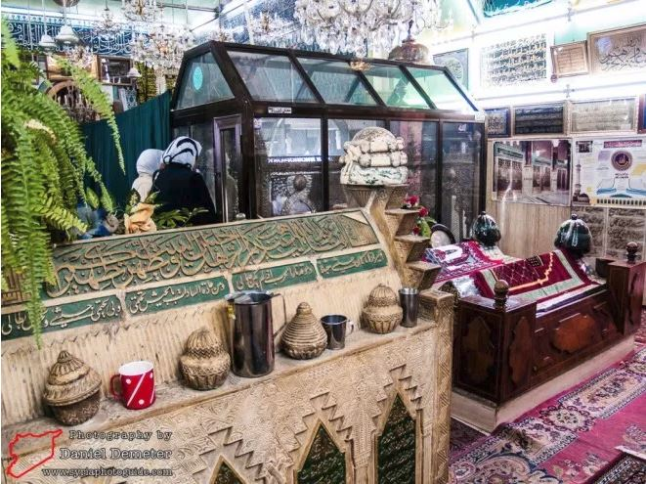
Grave of his famous disciple – Junaid & two sons

Slide 10
Overview
Spent life in studying, writing and teaching
Involved in social and political life of the community
Good terms with three kings
Initiated into the Sufi Way – 20 years old
Studied with ninety masters of religious sciences
Sufis of Andalusia

Slide 11
Literary Production
700 books. 400 Extant. The Futahat al-Makiyya – 17,000 pages. 560 Chapters
An Encyclopedia of Islamic Sciences
Qur’an, Hadith, Events in the Life of the Holy Prophet s.aw, Sharia, Fiqh
Divine names and attributes
The Relationship between God and the world
The structure of the cosmos
The make-up of the human being, the various human types
Stages of ascend to God
The ranks and kind of angles, nature of Jinn, the characteristics of time & space, symbolism of letters, the nature of the inter-world between death and Resurrection, Heaven and Hell, etc.

Slide 12
Ibn ‘Arabi’s Writings
“What we deposit in every chapter, in relation to what we have, is but a drop in the ocean.”
“In what I have written, I have never had a set purpose, as other writers. Flashes of divine inspiration used to come upon me and almost overwhelm me, so that I could only put them from my mind by committing to paper what they revealed to me. If my works evince any form of composition, that form was unintentional. Some works I wrote at the command of God, sent to me in sleep or through a mystical revelation...”

Slide 13
Best Known Works
Fusûs al-hikam ("The Bezels of Wisdom") Considered to be the quintessence of Ibn 'Arabi's spiritual teaching, it comprises twenty-seven chapters, each dedicated to the spiritual meaning and wisdom of a particular prophet. Over the centuries Ibn 'Arabi's students held this book in the highest esteem and wrote over one hundred commentaries on it.
Al-Futûhât al-makkiyya ("The Meccan Openings")
Written over 20 years – 17,000 pages.
Tarjuman al-ashwaq ("The Interpreter of Yearnings") This short collection of love poetry was inspired by his meeting during his first pilgrimage to Mecca with Nizam, the beautiful and gifted daughter of a great scholar from Isfahan. He later wrote a long commentary on the poems to prove to one of his critics that they deal with spiritual truths and not profane love. It was the first of Ibn 'Arabi's works to be translated into English.

Slide 14
Usage of Words
مشاکلہ – Same word used with different meanings…
ومکروا ومکراللہ واللہ خیرالماکرین
العین – Eye, Threading hole, essence, spy, guard, choice, prime, top, lord, master
Aqeeda of Hazrat Ibn Arabi r.h - Al-Futûhât al-makkiyya – Vol 1. pg 36

Slide 15
Three Levels of Knowledge
1. Knowledge through the intellect ('ilm al-'aql).. Some sound, some invalid
2. The knowledge of 'states‘
Immediate experience, no conceptual proof can ever establish that knowing
The knowledge of the sweetness of honey, the bitterness of aloes, the pleasure of intercourse, love, ecstasy, or passionate longing.
Impossible for anyone to know of this knowledge without directly experiencing it
3. The knowledge of the Divine Secrets
This is the knowledge that is beyond the stage of the intellect. It is knowledge of 'the inbreathing of the Holy Spirit in the heart,' and it is peculiar to prophets and saints.
This is 'all-encompassing knowledge‘ which embraces the entirety of knowable things!

Slide 16
Fusûs al-hikam ("The Bezels of Wisdom")
فص /فصوص
1. A Bezel - A groove holding the stone of a gem in its setting.
2. Essence
27 Chapters
Divine Wisdom, Angelic Inspiration, Divine Inspiration, Quddus, Love, Spirit, Light, Iman, Ihsan…

Slide 17
Hazrat Khalifatul Masih I (r.a)
“Hadhrat Muhiyudeen Ibn al-Arabi may Allah be merciful to him (1164 – 1240) predicted that a special minister of the promised one would be a Hafiz of the Quran. He writes thus ‘All his viziers will be non-Arabs none from among them will be an Arab. But they will speak in Arabic. One of them will be Hafiz of the Quran. He will not be of their kind. For he will never have disobeyed God. He will be the special minister of this promised one and the best of those who carry his trust.’ (Al- Futuhat al-Makkiya iii, 365)”. (Shahid, Hadhrat Maulana Dost Muhammad. Tarikh e Ahmadiyyat iii)

Slide 18
Tafsir - The Holy Qur’an
Sheikh Muhyiddin Ibn 'Arabi writes that he has understood new meanings from The Holy Praise each time he has read it although I cannot make such a claim…
“O ye who believe fight such of the disbelievers who are adjacent to you and let them find you unrelenting; and know that Allah is with those who are mindful of Him.” (9:124) ‘Such of the disbelievers who are adjacent to you’ Sheikh Ibn ‘Arabi writes: that the nearest disbeliever is our ego which disobeys Allah manifoldly. Thus the battle with that ought to be foremost.
So he writes about the nature of descent on page 262 of his commentary that ‘Jesus will descend but in the sense that he will be associated with a different body’

Slide 19
God – Wahdat-ul-Wujud & Wahdat-ush-shuhud
Two schools of thought among the Sufis in regards to God:
Oneness of Being (واحدة الوجود Wahdat-ul-wujud)
Oneness of Witnessing (واحدة الشھود Wahdat-ush-shuhud)
Wahdat-ul-wujud means “oneness of being”, or that the things God created are God Himself. (Pantheism)
Wahdat-ush-shuhud refers to the fact that God and his creation are entirely separate.

Slide 20
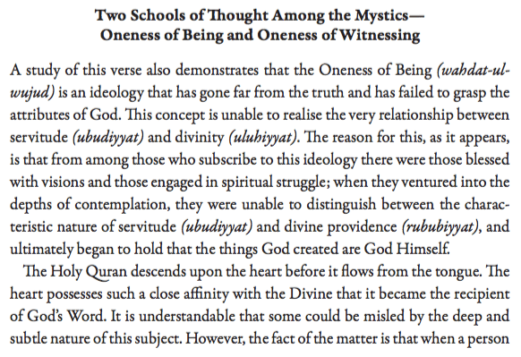

Slide 21
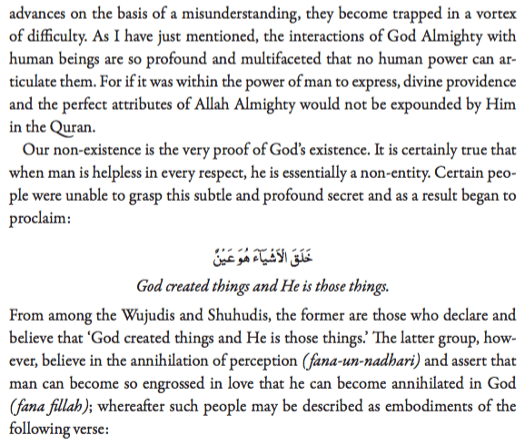

Slide 22
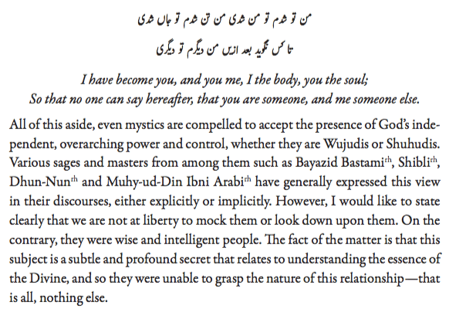
Malfuzat Vol 1. pg. 111-113

Slide 23
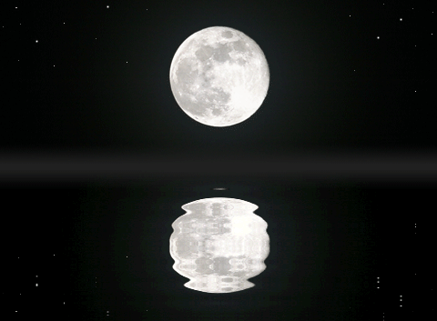
Everything in the universe reflects God's attributes, but it does not mean those things themselves become God. For example, the moon is reflected on water, but it seems as if the moon is in the water. In reality, the moon is moon and water is water, but it seems the moon has descended in the water. The interplay of water and the moon creates a beautiful relationship between the lowly and the high (and the ever-fluctuating and the Unchanged).
وَلِلَّـهِ الْمَشْرِقُ وَالْمَغْرِبُ ۚ فَأَيْنَمَا تُوَلُّوا فَثَمَّ وَجْهُ اللَّـهِ ۚ إِنَّ اللَّـهَ وَاسِعٌ عَلِيمٌ Unto Allah belong the East and the West, and whithersoever ye turn, there is Allah's Countenance. Lo! Allah is All-Embracing, All-Knowing. (2:116)

Slide 24
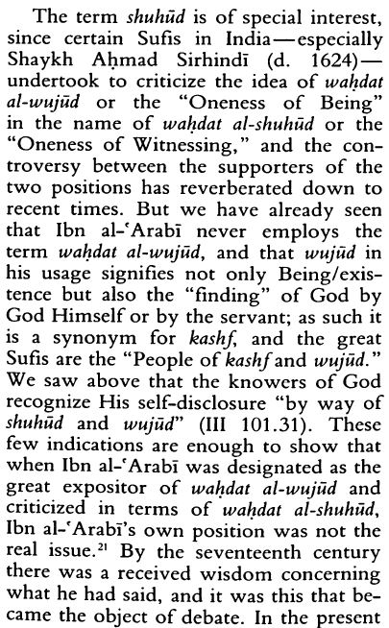
The Sufi Path of Knowledge pg. 226

Slide 25
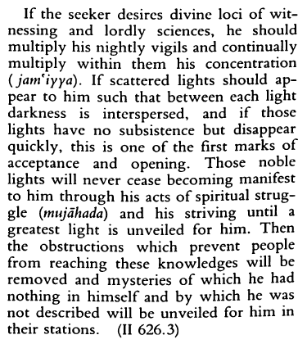
Page 223

